Slide 1

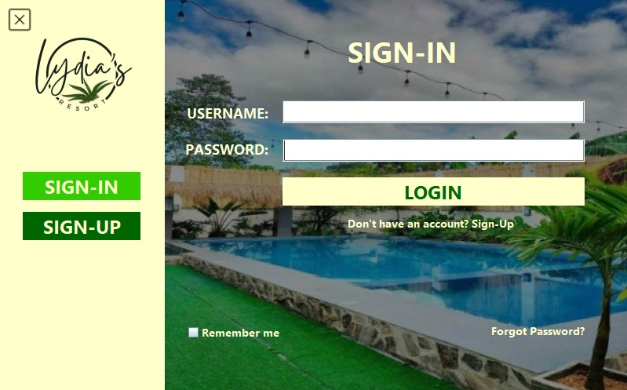
SIGN-IN PAGE
Enter your credentials here
Click to Login
Click to go to Sign-up Page
Click to save credentials
Click to recover accout

Slide 2
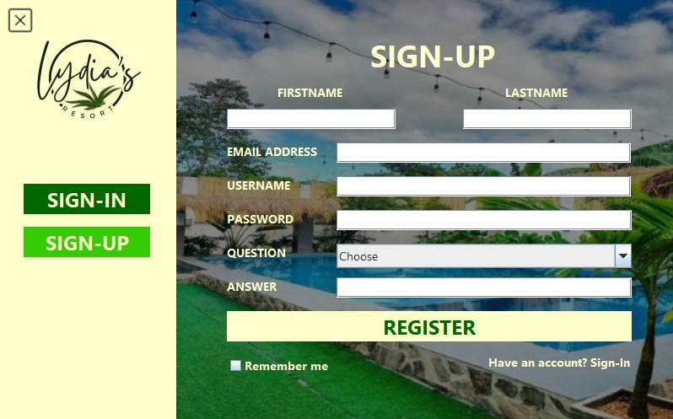
SIGN-UP PAGE
Enter the credentials asked to complete the form
First Name
Last Name
Email Address
Username
Password
Question
Answer
Click to register account
Click to go to Sign-In Page
Click to save credentials

Slide 3
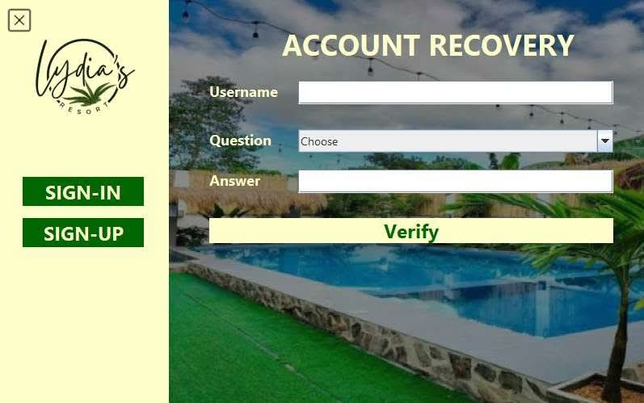
FORGOT PASSWORD PAGE
Fill up with the right credentials
Click to verify your credentials

Slide 4
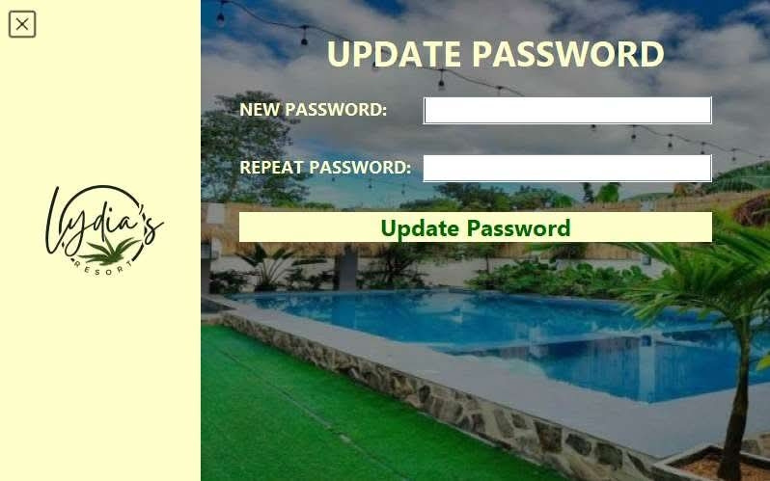
FORGOT PASSWORD PAGE
Create a new Strong password
Then repeat the password for double check
Click to change your password

Slide 5
ADMIN ACCOUNT

Slide 6
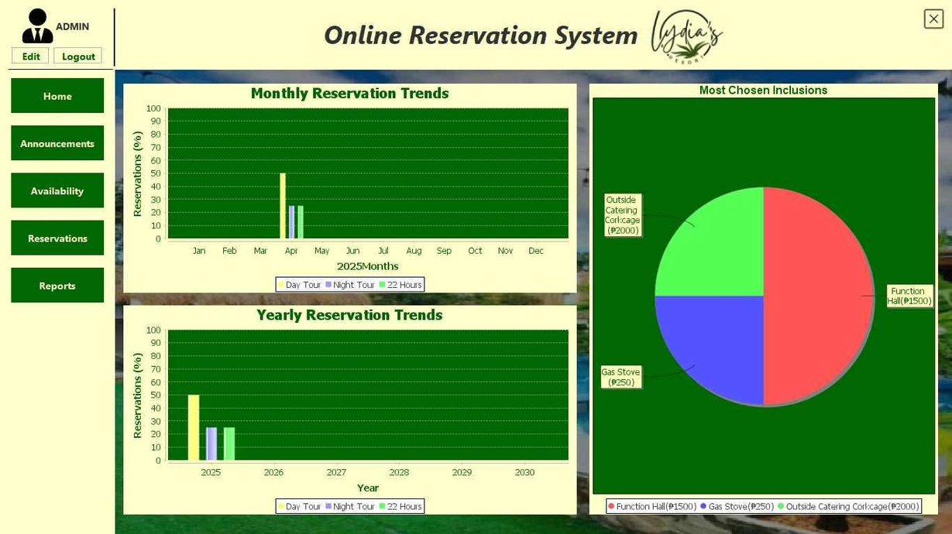
ADMIN HOME PAGE
Click to edit or logout
Click the buttons to go to
HOME
ANNOUNCEMENTS
AVAILABILITY
RESERVATIONS
REPORTS
View yearly/monthly trends and most chosen inclusion

Slide 7
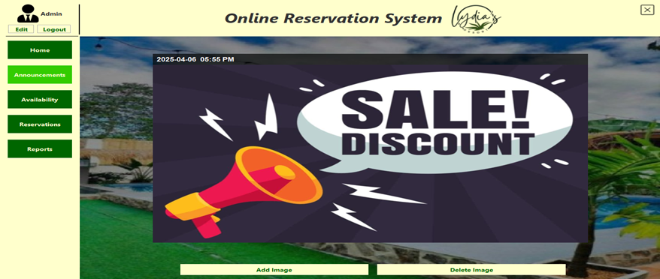
ADMIN ANNOUNCEMENTS PAGE
Delete Image
Add Image

Slide 8
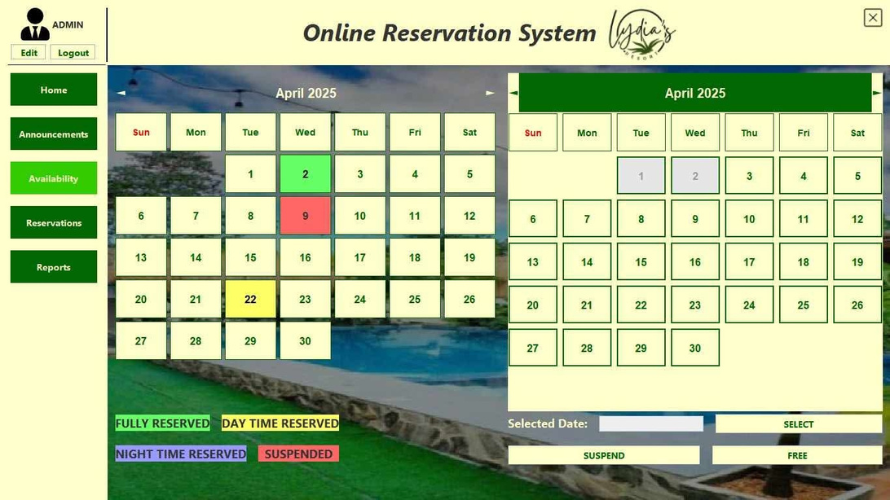
ADMIN AVAILABILITY PAGE
Color Codes:
Green - Fully Reserved
Yellow - Day Time Reserved
Blue - Night Time Reserved
Red - Suspended (Unavailable for reservations)
No Color - Free (Available for reservation)
Selecting a Date
Click on a date in the calendar.
The selected date will appear in the "Selected Date" field at the bottom.
Updating Status
Once a date is selected:
*Click SELECT to load the current status.
*Click SUSPEND to mark the date as unavailable.
*Click FREE to mark the date as available again.

Slide 9
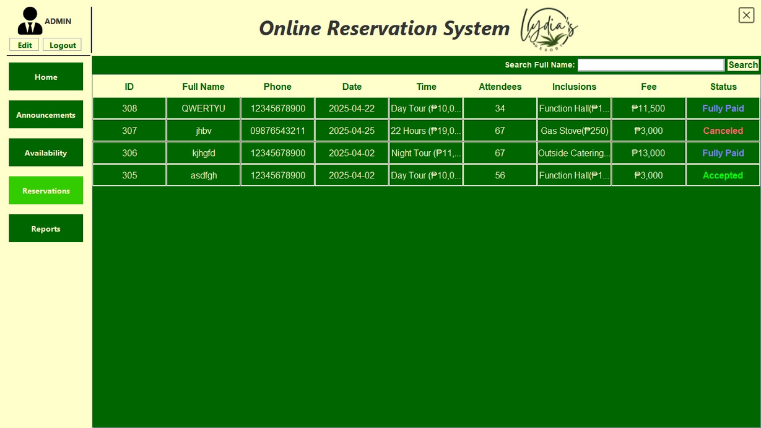
ADMIN RESERVATIONS PAGE
Reservation Table Columns
° ID: Unique identifier for each reservation.
Full Name: Name of the guest who made the Reservation.
Phone: Contact number of the guest.
Date: Date of the reservation.
Time: Type of tour and corresponding rate.
Attendees: Number of guests attending.
Inclusions: Any additional services (e.g., Function Hall, Gas Stove).
Fee: Total pant due or paid.
This is the reservation records where you can view the reservation details and you can click on the status to mark it as canceled or fully paid, you can click on the damage fee to add a damage fee or to add a damage fee that is already paid

Slide 10
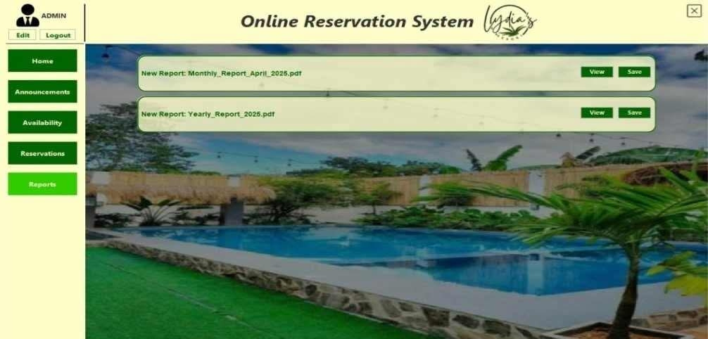
ADMIN REPORTS PAGE
View Reports: Opens the selected report in PDF format for on-screen review
Save Reports: Downloads the report for offline use or archiving

Slide 11
STAFF ACCOUNT

Slide 12
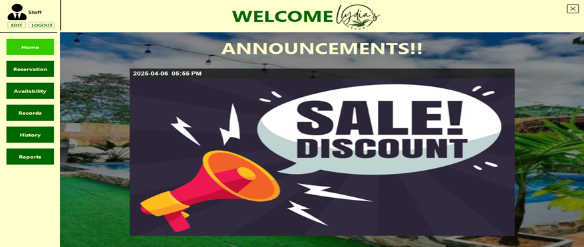
STAFF HOME PAGE
Click to edit or logout
Click the buttons to go to
HOME
RESERVATION
AVAILABILITY
RECORDS
HISTORY
REPORTS
View Announcements

Slide 13
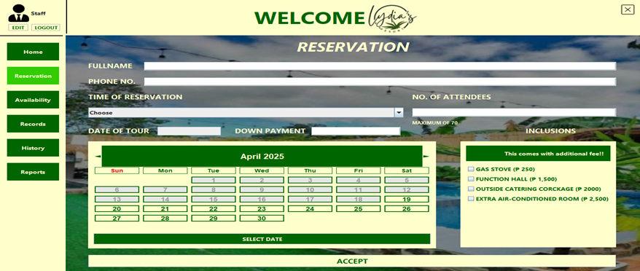
STAFF RESERVATION PAGE
Fields
Full Name: Name of the client making the reservation.
Phone No.: Contact number of the client.
Time of Tour: Dropdown with options (e.g., Day Tour, Night Tour, 22 Hours).
No. of Attendees: Up to 70 guests.
Date of Tour: Selectable through a calendar interface.
Reservation Fee: Must be atleast 3000php
Inclusions (Optional with Extra Fees):
Gas Stove (250)
Function Hall (1,500)
Outside Catering Corkage (2,000)
Extra Air-Conditioned Room (2,500)
Click to make reservation

Slide 14
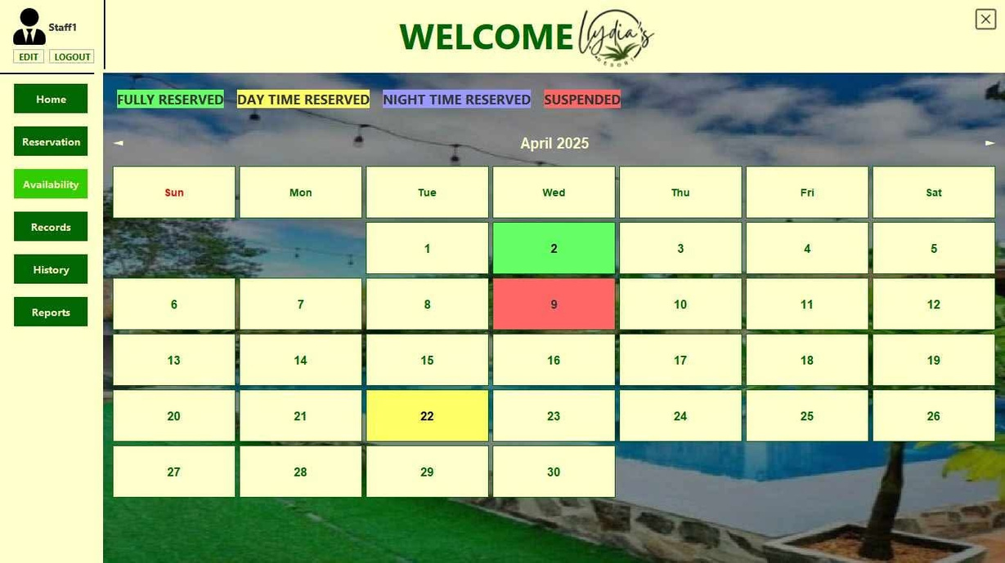
STAFF AVAILABILITY PAGE
Color Codes:
Green - Fully Reserved
Yellow - Day Time Reserved
Blue - Night Time Reserved
Red - Suspended (No reservations allowed)

Slide 15
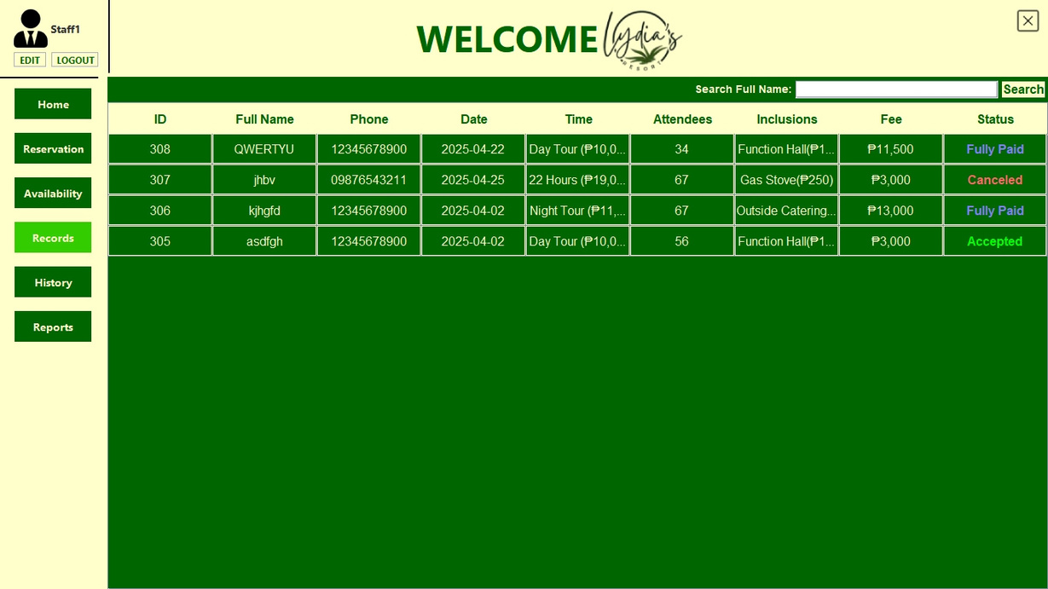
STAFF RECORDS PAGE
This is the reservation records where you can view the reservation details and you can click on the status to mark it as canceled or fully paid, you can click on the damage fee to add a damage fee or to add a damage fee that is already paid

Slide 16
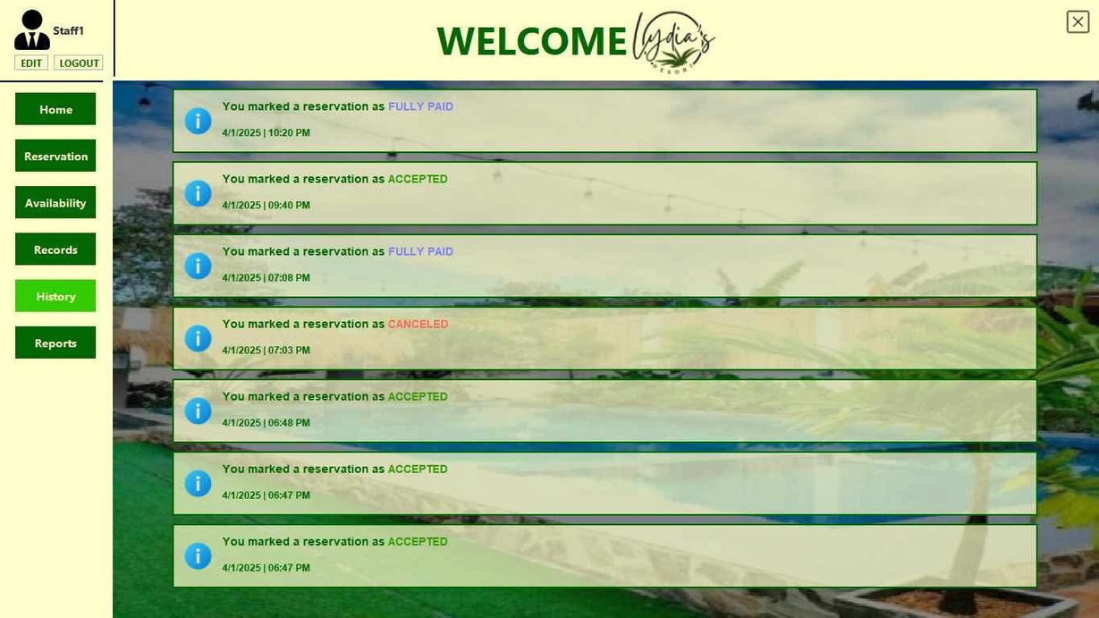
STAFF HISTORY PAGE
Click to view the reservation details made when the action was taken

Slide 17
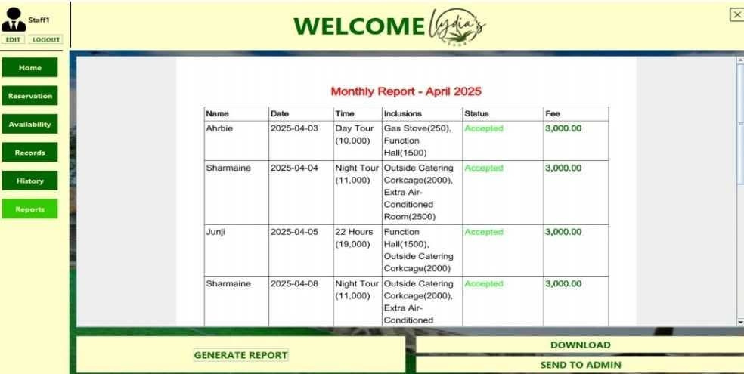
STAFF REPORT PAGE
Saves a copy of the report for external use
Click to automatically generate a report of your choice
Forwards the report directly to the administrator

